Slide 1
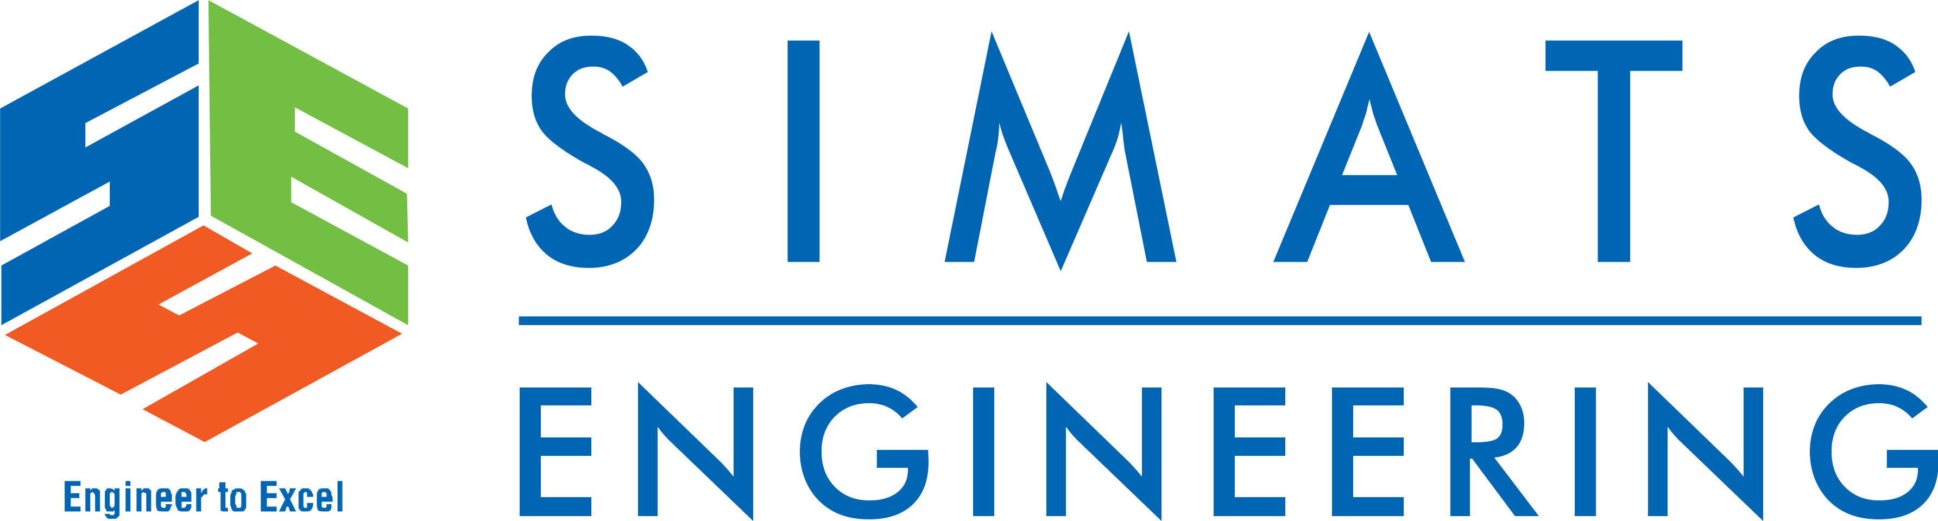

Multi-Tenant SaaS-Based Student Learning Management System
CSA1522-CLOUD COMPUTING & BIG DATA ANALYTICS
Guided by :
Dr. Rajaram P
Name of the student :
K.Dhilip(192365013)
Sanjay kumar soy(192311151)
T.Subahan(192511121)

Slide 2
Introduction
A Learning Management System (LMS) is a software application used to manage online learning activities.
Traditional LMS platforms often require separate installations for each institution, leading to higher costs and maintenance.
A Multi-Tenant SaaS LMS enables multiple educational institutions to use a single cloud-based application while keeping each institution's data isolated and secure.
Cloud technologies provide scalability, reliability, and easy access from anywhere using the internet.
Notes:
Image source: https://pub.mdpi-res.com

Slide 3
Abstract
This project presents a Multi-Tenant SaaS-Based Student Learning Management System that allows multiple educational institutions to share a single cloud-hosted application while maintaining complete data isolation for each tenant. The system provides secure user authentication, role-based access control, course management, online assessments, and subscription billing. By adopting cloud computing techniques such as multi-tenancy, load balancing, and auto-scaling, the platform delivers high availability, reduced infrastructure costs, and simplified maintenance. The proposed solution improves learning accessibility, supports institutional growth, and offers an efficient Software-as-a-Service (SaaS) model for modern education.
Notes:
Image source: https://www.mdpi.com

Slide 4
Problem statements
Traditional Learning Management Systems require separate installations and servers for each institution, resulting in high deployment and maintenance costs.
Managing users, courses, and assessments across multiple institutions becomes difficult without secure data isolation and centralized administration.
Existing systems often struggle to handle increasing numbers of users during peak academic periods due to limited scalability and inefficient resource utilization.
Notes:
Image source: https://www.mdpi.com

Slide 5
Objectives
To design a cloud-based multi-tenant learning management system that securely serves multiple educational institutions using a single shared application.
To provide efficient course management, online assessments, and role-based access control for administrators, faculty, and students.
To improve scalability, availability, and cost efficiency using SaaS architecture, load balancing, cloud auto-scaling, and subscription billing.
Notes:
Image source: https://pub.mdpi-res.com

Slide 6
Literature Review
No. | Journal / Reference | Algorithm / Technology | Advantages | Disadvantages | Research Gap
1 | Ahmed et al., International Journal of Educational Technology in Higher Education, 2025 | Cloud LMS, Gamification | Improves student engagement | Course-specific | No multi-tenant LMS
2 | Sharma et al., Indian Journal of Computer Science and Technology, 2025 | Multi-Tenant SaaS, Kubernetes, RBAC | Scalable and secure | Not education-specific | No course and assessment features
3 | Yin et al., Journal of Northeastern University, 2026 | ACO, SaaS Multi-Tenancy | Supports different tenant requirements | Computational complexity | No LMS and billing integration
4 | Murali, Journal of Cloud Computing, 2026 | Hypergraph-based Resource Scheduling | Improves cloud resource utilization | Complex implementation | No student LMS functionality

Slide 7
Module 1 – Multi-Tenant Architecture & User Management
Supports multiple institutions within a single cloud application.
Maintains secure and isolated data for each institution.
Provides separate dashboards for administrators, faculty, and students.
Features
Tenant Registration
User Authentication
Role-Based Access Control (RBAC)
User Profile Management
Secure Login
Notes:
Image source: https://pub.mdpi-res.com

Slide 8
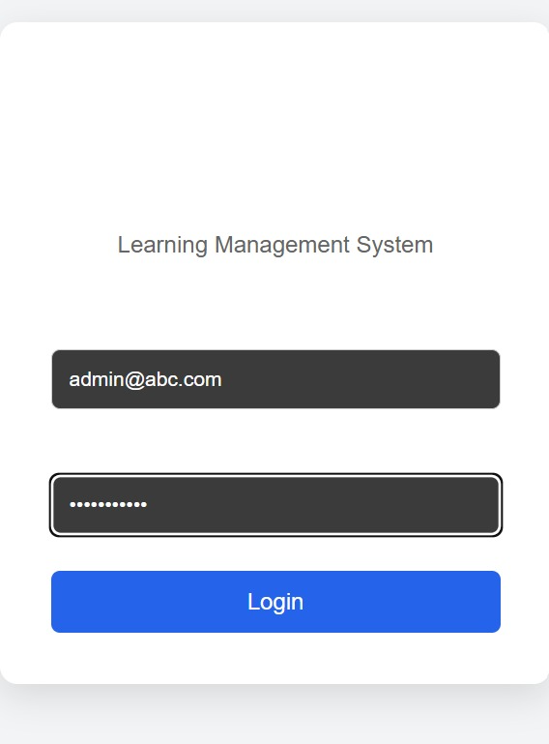
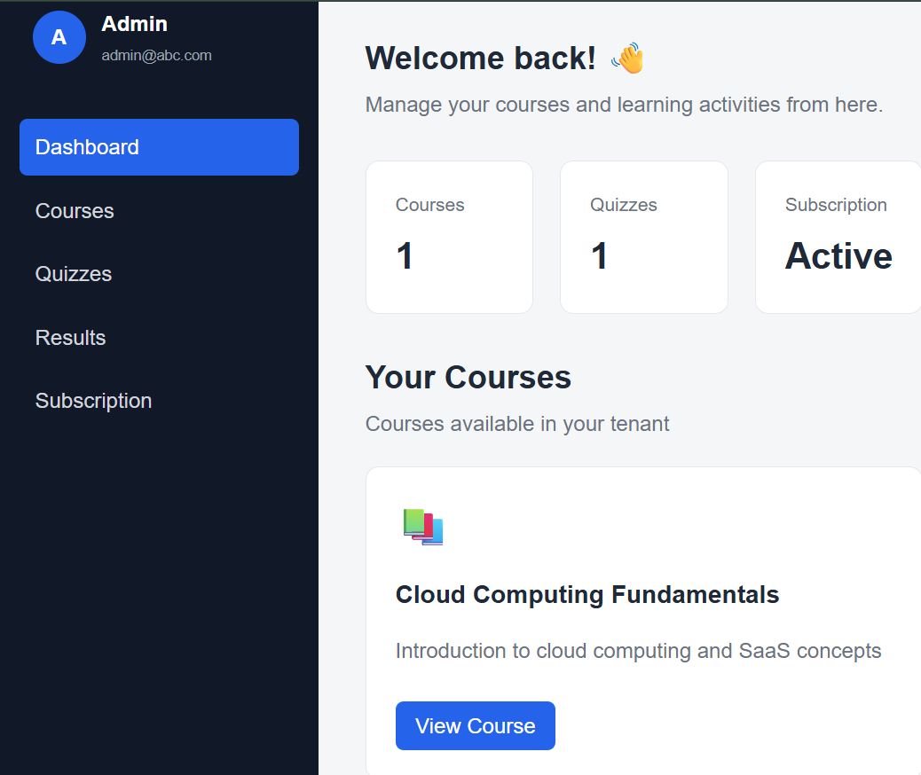
Module 1: Output

Slide 9
Module 2 – Course Content & Assessment
Enables faculty members to manage academic activities online.
Students can access learning materials and complete assessments.
Features
Course Creation
Content Upload
Assignment Submission
Online Quiz
Marks Management
Progress Tracking
Notes:
Image source: https://pub.mdpi-res.com

Slide 10
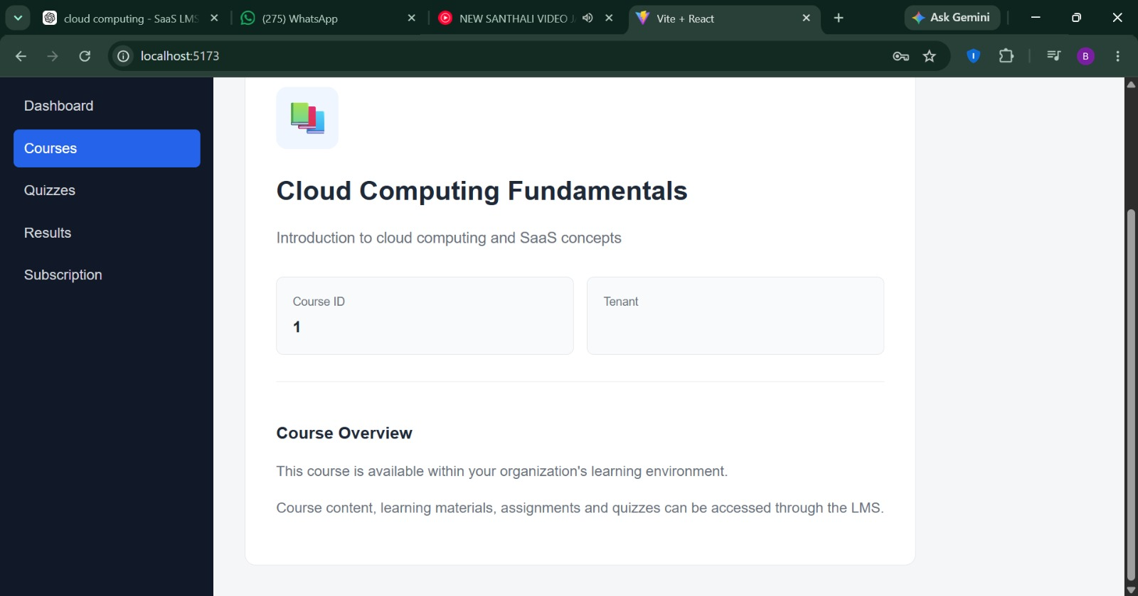
Module 2: Output

Slide 11
Module 3 – Cloud Deployment & Subscription Billing
Deploys the LMS on a cloud platform.
Provides subscription plans for different educational institutions.
Features
Cloud Hosting
Subscription Management
Payment Processing
Billing Reports
Auto Scaling
Usage Monitoring
Notes:
Image source: https://pub.mdpi-res.com

Slide 12
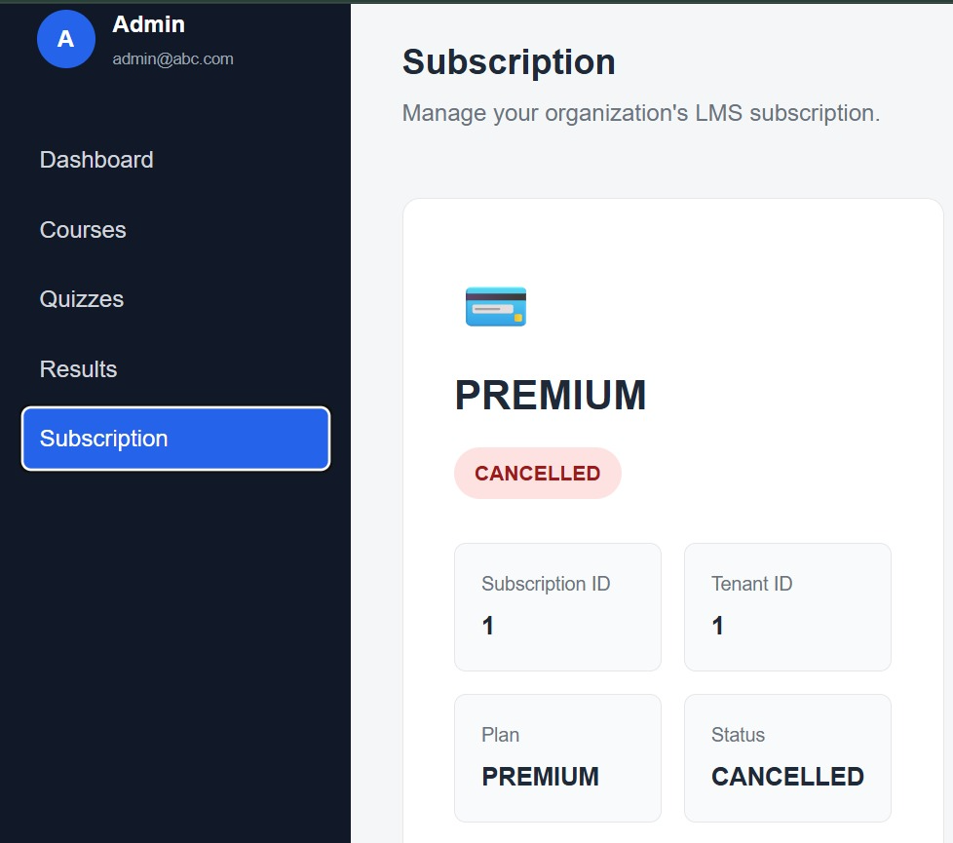
Module 3: Output

Slide 13
Techniques Used
Multi-Tenancy Architecture
SaaS Design Patterns
Role-Based Access Control (RBAC)
Load Balancing
Cloud Auto-Scaling
Secure Authentication
Cloud Storage
Notes:
Image source: https://pub.mdpi-res.com

Slide 14
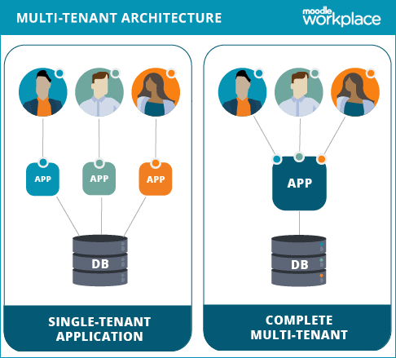
Applications
Schools
Colleges and Universities
Online Learning Platforms
Coaching Centers
Corporate Training Organizations
Government Training Institutes
Skill Development Centers
Professional Certification Programs
Notes:
Image source: https://www.mdpi.com

Slide 15
Future Scope
AI-Based Learning – Add AI for personalized course and study recommendations.
Mobile Application – Develop Android/iOS apps for students and teachers.
Advanced Analytics – Predict student performance and identify at-risk students.
Scalable Cloud Infrastructure – Support thousands of institutions and users.
AI Chatbot – Provide 24/7 assistance for course and student queries.
Advanced Subscription Plans – Add flexible plans, automated billing, and payment management.

Slide 16
Conclusion
The proposed Multi-Tenant SaaS-Based Student Learning Management System provides an efficient, scalable, and secure solution for managing educational activities across multiple institutions.
By integrating cloud computing, multi-tenancy, role-based access control, load balancing, and auto-scaling, the system reduces operational costs while improving accessibility and performance.
This approach enables institutions to deliver high-quality online education through a centralized, reliable, and cost-effective cloud platform.
Notes:
Image source: https://pub.mdpi-res.com

Slide 17
References
Azouzi, S., & Ayachi Ghannouchi, S. (2025). “Designing Multi-Tenant E-Learning Systems in the Cloud: A Process-Oriented Approach for Higher Education.” International Journal of Computer Applications, 187(10), 16–24. DOI: 10.5120/ijca2025924998. (IJCA)
Ahmed, H. M. M., El-Sabagh, H. A., & Elbourhamy, D. M. (2025). “Effect of Gamified, Mobile, Cloud-Based Learning Management System (GMCLMS) on Student Engagement and Achievement.” International Journal of Educational Technology in Higher Education, 22, 49. DOI: 10.1186/s41239-025-00541-1. (Springer)
Sharma, H. R., Mondhe, T. Y., Kumbhare, B., & Kanekar, Y. (2025). “Design and Evaluation of a Multi-Tenant SaaS Platform for Scalable and Secure Application Delivery.” Indian Journal of Computer Science and Technology, 4(2), 227–232. (indjcst.com)
Murali, J. A. (2026). “Hypergraph-Based Adaptive Resource Scheduling for Fault-Resilient Multi-Tenant Cloud Allocation.” Journal of Cloud Computing. DOI: 10.1186/s13677-026-00925-2. (MDPI)
Mthwazi, G., Kapepo, M., & Van Belle, J.-P. (2026). “The Use of Learning Management Systems for Self-Paced Learning: The Case at a South African Public Access Centre.” Published 13 August 2026. (arXiv)

Slide 18


Slide 19
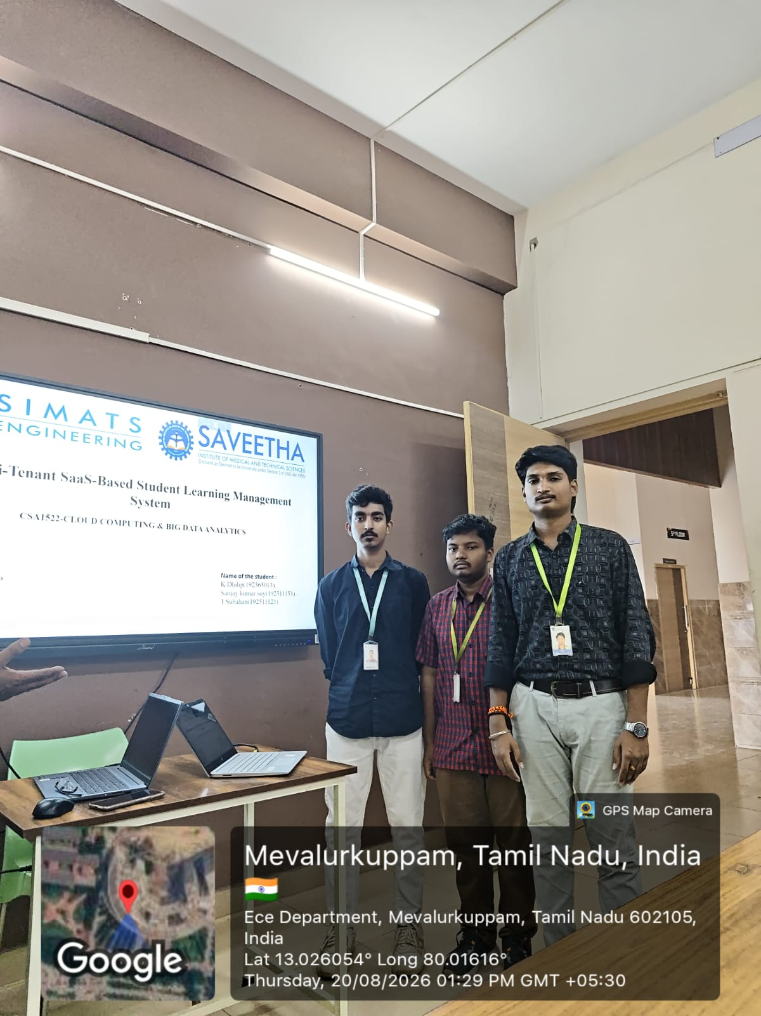
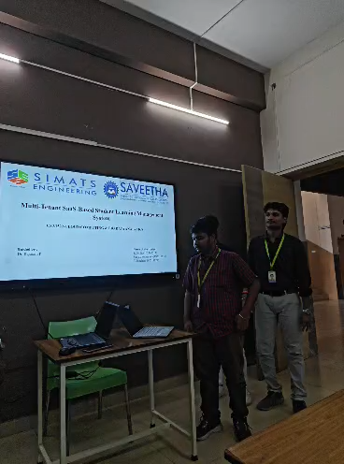
GPS Photo

